Slide 1
Physics 218 Instructor: Jaylene Naylor
Welcome Back!
LOG INTO MOODLE
2 PEOPLE TO A GROUP

Slide 2
Today
Attendance
Lab open hours
Office hours – M 2-3, W 11-12. Happy to meet with you other times!
Syllabus overview
Equation writing options, Word, LaTeX, Jupyter notebooks
Python
Review of plotting code – linear least squares fitting
Functions, vectorization, using github to share and save your code

Slide 3
Syllabus overview
Syllabus – SCHEDULE w/ exams
You MUST do your OWN WRITE-UP!
Lab and Prelab quizzes MUST be done on your own, but you may use notes/lab notebook
2 full write-ups, 10 in class quizzes, 11 prelab quizzes
We will drop the lowest score of the 10 quizzes and the lowest prelab score. NEITHER of the scores from the 2 full write-ups will be dropped. If you miss one of them, you will need to work with me to select another lab for which to do a full write-up
Prelab quizzes open Friday 8am and close 11:59pm the day before your lab section
Lab reports due at the beginning of the following lab meeting.

Slide 4
Lab write-ups
Lab write-up guidelines and sample writeup doc on Moodle
Pick up your write-ups from last semester
Grading rubric

Slide 5
SECTION | NOTES | POINTS
Title | Title, Date, Name, Partner Names | 2
Abstract | What, why, how, summary of results | 8
Introduction | Theoretical equations for two objects for Method 1 (5) Derivation of τ = rm(g-a) including τ = Iα. Define variables and discuss in between steps (10) | 15
Data and Analysis | Method 1: M, δM, R, δR, L, δL and why for errors (6 for errors) I, δI with equations for each config (8) Method 2: Raw data table for each disk config (4) r, δr, m, δm with reasons (4) τ, δτ, α, δα with equations (10) Discuss how to get I out of graph (3) Missing units (5 points, not included in total) | 35
Graphs | 2 graphs Title (2), Axes Labels and units (4), proper units on slope, intercept and errors(2), comment on goodness of fit (2) | 20
Conclusions | Restate results and compare to theoretical (10) If results do not agree (likely, for this lab), comment on the greatest fractional uncertainty and that the error is likely systematic (10) | 20
:
Notes:
Ctrl-1 for zooming on my laptop with Zoomit installed

Slide 6
Review
Error Document
Read through again in its entirety.
Quiz will include error propagation, precision vs accuracy, etc
Random errors – reduce how? Example?
Systematic errors – example?
Precision – which has higher precision? Look at fractional uncertainties
Accuracy – which is most accurate compared to g?
9.75 ± 0.01 m/s² 9.75 ± 0.53 m/s²

Slide 7
Review
Results paragraph: State results with uncertainties as your first sentence!! Then state whether results agree with accepted value within their uncertainties.
IF results do not agree, need to look at WHY. Run some numbers and see if your thoughts are reasonable. This will be required for this semester’s lab writeups
Plotting – which variable goes on the y axis? Look at largest fractional uncertainty. WHY?

Slide 8
Make your life with equations easier – 2 options
LaTeχ
What is it? Typesetting system
Resources
Overleaf – has great templates
Dr. McCrady’s LaTeX Basics on Moodle (ignore part about creating output on Unix system)
LaTeX Sample File and pdf figure
LaTeX cheat sheet
Write LaTeX in Jupyter notebooks

Slide 9
Equations, cont
Microsoft Word
Many LaTeX symbols work in Word!
See Cheat Sheet on Moodle
Alt = is the shortcut to start an equation
Let’s check it out

Slide 10
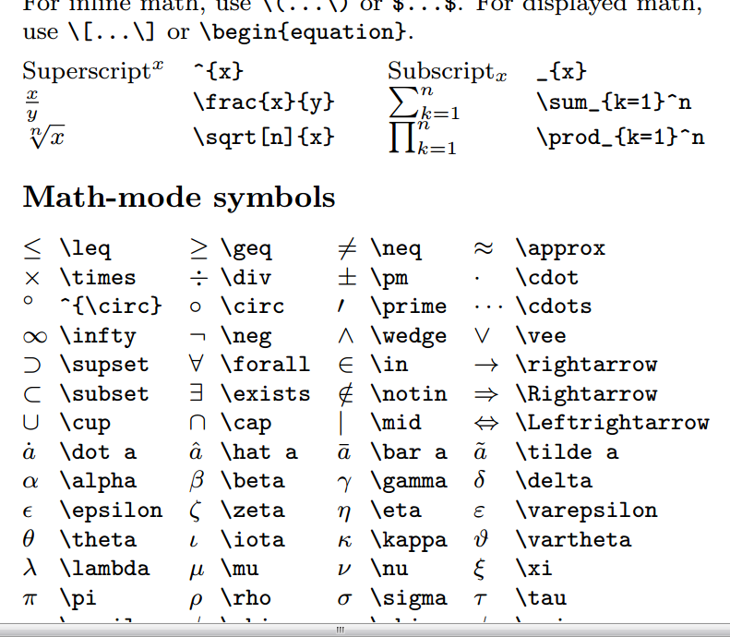
Cheat Sheet

Slide 11
TWO possible methods for data and error analysis
All data and error analysis done in Excel, then enter arrays into Python code for plotting as we did last semester
All data is entered in Python code as arrays. Data and error analysis is done using array operations and functions. (for a couple of our labs, this is somewhat complicated)

Slide 12
Python for all your data analysis!
Use Python for all your analysis using arrays!
FUNCTIONS!
Vectorization – can do operations on arrays all at once
Use jupyter notebook
Benefits – can use markup to create a document. Can write in LaTeX.
EXAMPLE of what you can do with a notebook
In fact, writing your lab report in jupyter notebook is totally acceptable to me.

Slide 13
Functions and other new stuff in Python
Why? So we don’t have to rewrite code over and over!
Open up Anaconda and create a new jupyter Notebook
Look at Markup and LaTeX.
Make sure to execute all cells.
Functions, vectorization examples – do together

Slide 14
How to turn in your notebooks
Go to GitHub and create an account.
Verify account through email they sent you
Start a project
Create a public repository. Check ”initialize with readme”
Upload your file. Commit changes.
Click on the file and make sure it displays the plot.
Copy URL in address bar for the code file. Paste it into Moodle quiz.

Slide 15
Let’s practice!
Upload functions practice code file we just did together

Slide 16
This week’s quiz
Make sure you know how to use error analysis rules
Precision and Accuracy
Understand how functions are used in Python
Turn in link to your github code from today’s lab on Moodle before the end of the in class quiz.
Prelab Quiz for Standing Waves opens Friday 8am. Closes night before your lab at 11:59pm

Slide 17
How to Be Successful in Lab
Set reminders to take your prelab quizzes!
Come to lab every time!
Check your email frequently
Check Moodle frequently
Read through whole lab (and complete the derivations) before taking prelab quiz
Even if it’s a quiz week, make sure you have ALL of your data analysis done before attempting quiz.
ASK QUESTIONS, come see me or email me!!!!
Turn in drafts of lab reports if you want help

Slide 18
LAB FOR TODAY
Download the More Python Lab and Quiz Prep doc
Don’t forget to take pre-lab quiz for next week!

